Slide 1
Filmmaking 101

Slide 2
All films are made three times:
Pre-production:Script/Storyboard/Shotlist
2. Production:The Shoot
3. Post-production:Editing/Score

Slide 3
1. PRE-PRODUCTION
Scripts can be broken down into:
Acts (usually three: beginning, middle, end – though not necessarily in that order, as Godard pointed out!)
Scenes
Shots

Slide 4
However, first and foremost ask yourself: What is the purpose of my video?
To introduce my company / service?
To show my product / service?
Give a look at your work?
ETC…

Slide 5
Once you can identify its PURPOSE you can make better-informed decisions about shot elements such as:
Locations
Props
Characters
Etc.

Slide 6
Any given scene is broken down into a series of shots.
There are three main types of SHOT:
Wide-shot (also called an establishing shot)
Mid-shot
Close-up

Slide 7
So before shooting, you should have a story, i.e.
Know roughly what your beginning, middle and
end are going to be.
List out the scenes in each of these three “Acts”.

Slide 8
Having done this, take each “Scene” and break it
down further into shots.

Slide 9
For example:
Shot 1: W-S Carpark. Blue Mini screeches in off the road.
Shot 2: M-S Car door flung open, long stockinged leg in six-inch heels steps out.
Shot 3C-U Reaction shot of Car Park Attendant’s mouth dropping open.
Shot 4 …etc.

Slide 10
This is called doing a Shot List – bring this piece of paper (your shot list) on your shoot and cross off each shot once finished.
This prevents getting to the edit stage and realizing you forgot to shoot the climactic car chase scene or some important insert!

Slide 11
Storyboards
It is often helpful to do little storyboards (like a comic strip) of your shots – make sure the numbers match your shot list.
This will help you make better decisions about camera placement, angles, size of shot, whether the camera moves during the shot, composition.

Slide 12
Shot Composition and Framing
The “Rule of Thirds” is probably the simplest way to approach framing – this is an age-old technique, developed by painters centuries ago, to achieve symmetry and balance in their work.

Slide 13
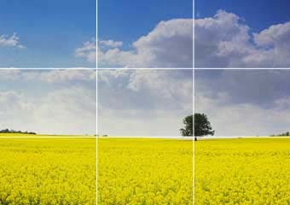
Composition: Rule of Thirds

Slide 14
Rule of Thirds
Divide your frame into nine panels by:
Drawing Two equidistant Vertical Lines
Drawing Two equidistant Horizontal Lines
Generally, our eye is most attracted to the “lines” and “crosshair points.”
Put the most important elements of your frame THERE.

Slide 15
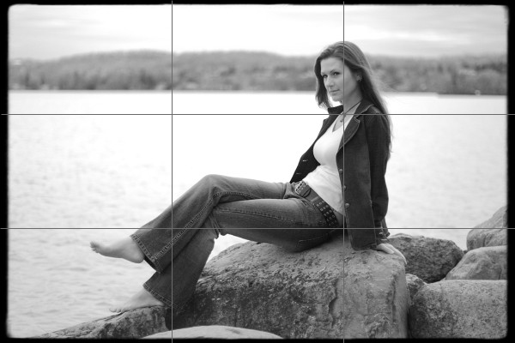

Slide 16
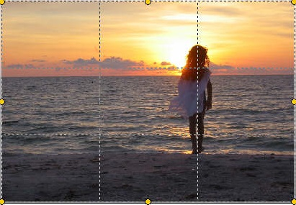
How would you ‘fix’ this shot?

Slide 17
Mise-en-Scene
At its most basic, mise-en-scene is the elements in a shot: look closely at advertisements (or master filmmakers’ work) for examples of this: nothing, absolutely nothing, in the shot will be random or unconsidered.

Slide 18
Mise-en-Scene (contd)
Everything, e.g. the pattern on the carpet the character is walking across, will be considered (e.g. Kubrick reversing the carpet pattern in The Shining to suggest mind ‘flipping’.)

Slide 19
Obviously we can’t do anything like this BUT we can carefully choose colours, fabrics, buildings,props, etc, etc, etc, to convey key qualities as identified initially when deciding what the PURPOSE of the video is.
What are you trying to evoke in viewer?

Slide 20
Other factors to consider at this stage include:
Shooting off aTripod vs Handheld.
Do you need Ambient Sound? If so, is onboard mic adequate?
Shooting ratio: number of takes per shot. Aim to keep it low, e.g. 3:1
This prevents ending up with loads of unused footage in the edit.

Slide 21
Recap
Clear Purpose for the piece
Beginning Middle End
Shot List
Sense of composition/framing for each shot (storyboard)
Elements in each shot (props, locations, etc)
Equipment checked

Slide 22
Once all of these key decisions are made we are ready for the next stage…

Slide 23
2. PRODUCTION: THE SHOOT
If you are shooting anywhere you don’t own / have access to make sure to check in advance you can get in / won’t be asked to stop filming by a security guard, etc.

Slide 24
Recce
If needs be, do a Recce in advance, a few days before preferably, so if there is a problem you can find a solution rather...
...than messing around on the day.

Slide 25
Unlike what you hear, everything CANNOT be fixed in Post! Or it will take a skilled technician lots of time.
To avoid this, before shooting, re-check:

Slide 26
White balance – is the setting correct on your camera?
Focus – is the image sharp?
Sound – is it crisp and clear?

Slide 27
Once happy, get out your Shot List and knock shots off one by one! Also, don’t forget to press RECORD on the camera…seriously! It does happen people forget this last little detail.
Now we’re ready for the final phase.

Slide 28
3. POST-PRODUCTION: EDIT
The first step in this process is capturing what you’ve shot.
For a short piece there is no need to log the footage as it comes into your hard drive.

Slide 29
View each take, decide on the best one, and then place it on the timeline to do an
ASSEMBLY or ROUGH CUT.

Slide 30
Once you are happy that the narrative flow is good, you can then focus on the audio / music.

Slide 31
Play around with this until you are happy.
Make last tweaks to arrive at Final Cut.
Hit EXPORT! Voila your first masterwork!

